Slide 1
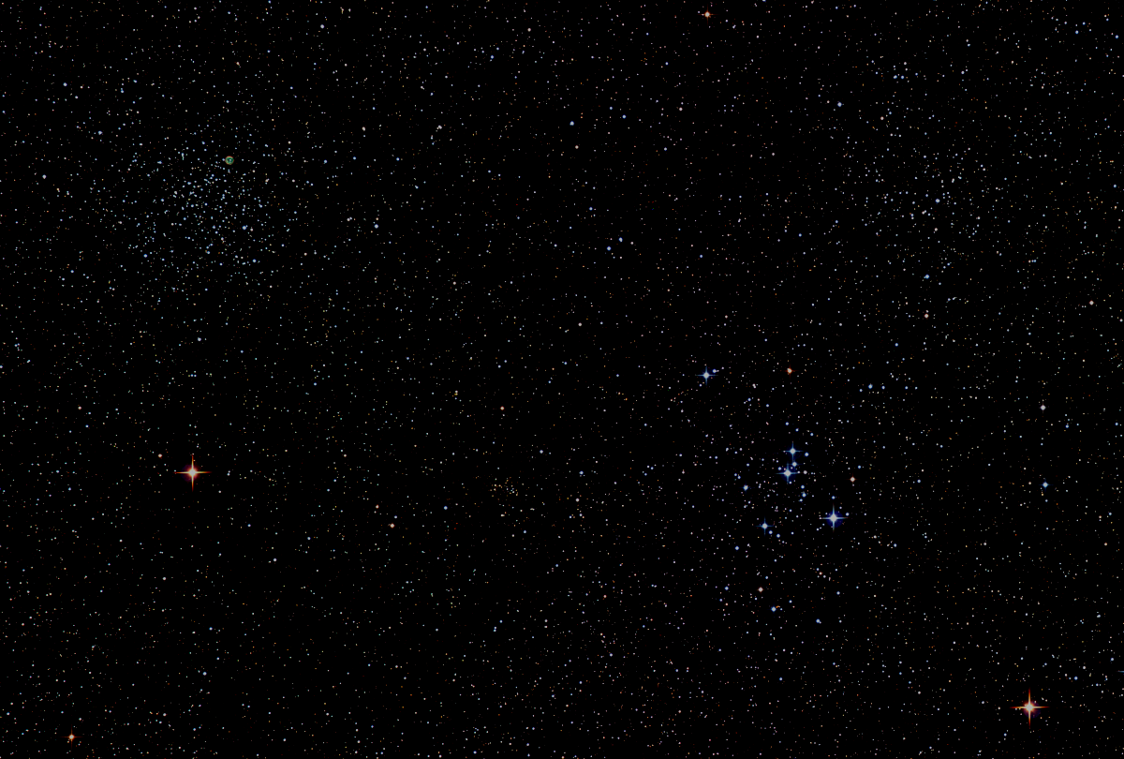

Howard
Astronomical
League
19
Annual Meeting
January 17th, 2019
Notes:
Howard Astronomical League, June 21, 2018

Slide 2
Introductions

Slide 3
Annual Business
2019 Board Election – Wayne Baggett
2018 Financial Summary – Bob Savoy

Slide 4
HAL 2018 Financial Summary
2018 Starting Bank Balance: $9,354
2018 Income
Memberships: $4,644
Equipmt sale: $ 592
Other: $ 939
2018 Cash added to Bank: $6,175
2018 Expenses
Recurring: $2,653 (Note 1)
Non-recurring: $4,928 (Note 2)
2018 Cash spent from Bank: $7,581
2018 Ending Bank Balance: $7,948
Notes
Note 1: AL & IDA & CSC dues, Insurance, Website, Mailbox
Note 2: Materials and supplies needed to keep HALO operating and in good condition
HAL Membership Stats
12/31/16: 219
12/31/17: 263
12/31/18: 246

Slide 5
Upcoming Events
HAL Events – Alpha Ridge Park
January 20th 10pm – Total Super Moon Eclipse
March 16th at 7pm – Public Star Party
April 6th at 7:30pm – Members Star Party
Other Events
February 4th – 10th Winter Star Party, Scout Key, FL

Slide 6
This Evening’s Speaker
Bob Dutilly
NASA/GSFC, Retired
HAL 2nd Vice President
Spacecraft Mission Development
Notes:
It is my distinct pleasure to introduce Dr. Bindu Rani. She has been a Postdoctoral Fellow at NASA/Goddard Space Flight Center since July 2016, and will continue to hold that post until June 2019. She was also a Postdoctoral Fellow at the Max-Planck-Institut für Radioastronomie Bonn, Germany from February 2014 to June 2016. She has held visiting scientist and researcher positions at the Korean Very Long Baseline Interferometry Network of the Korea Astronomy and Space Science Institute, and The Gra-dig-nan Bordeaux Nuclear Research Center in France. Dr. Rani has experience in Gamma-ray, X-ray, optical, and radio astronomy. Her optical observational experience includes use of the 1.04 meter telescope at AIRES, Na-in-i-tal, India, and the 1.20 meter telescope at Mount Abu, India.
Among her many achievements, Dr. Rani was awarded the Otto Hahn Medal for outstanding scientific achievements by the Max Planck Society in 2015. She holds Bachelor and Master of Science degrees from University of Delhi and Da-yan-and University, respectively, in India. Last, and certainly not least, Dr. Rani completed her Ph.D at Max-Planck-Institut für Radioastronomie and University of Köln, both in Germany in 2013.

Slide 7
Member
Astrophotos and Sketches

Slide 8
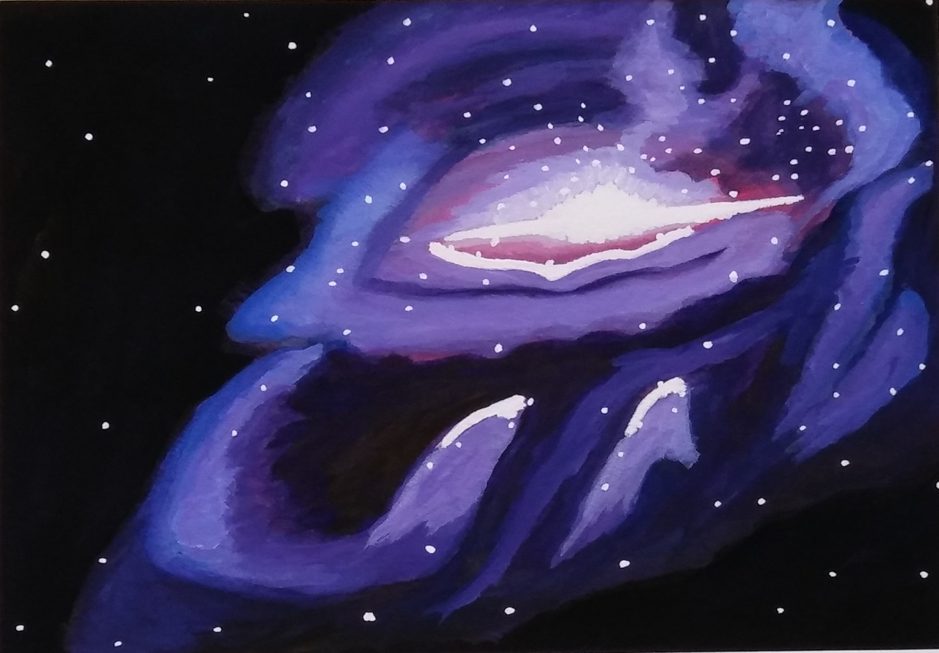
Eye of God Nebula
Forest Arnold

Slide 9
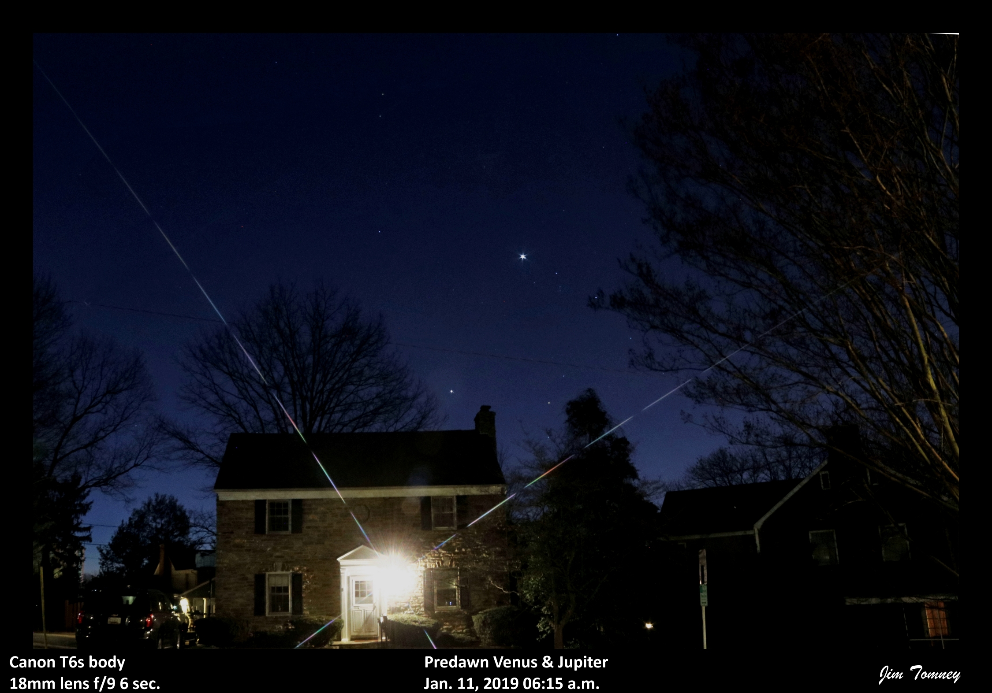
Duane Dehnert

Slide 10
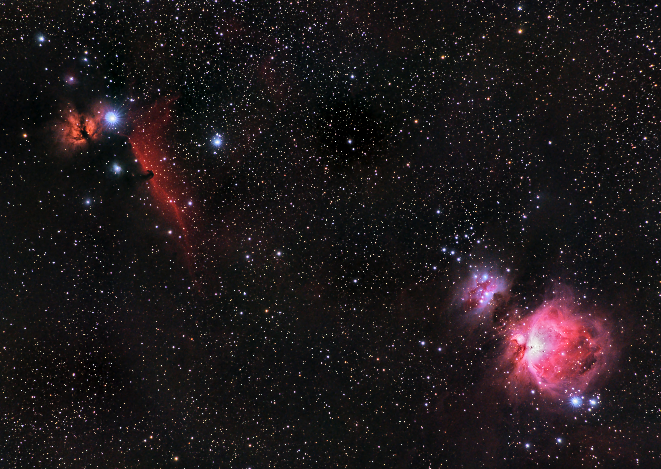
Victor Sanchez

Slide 11
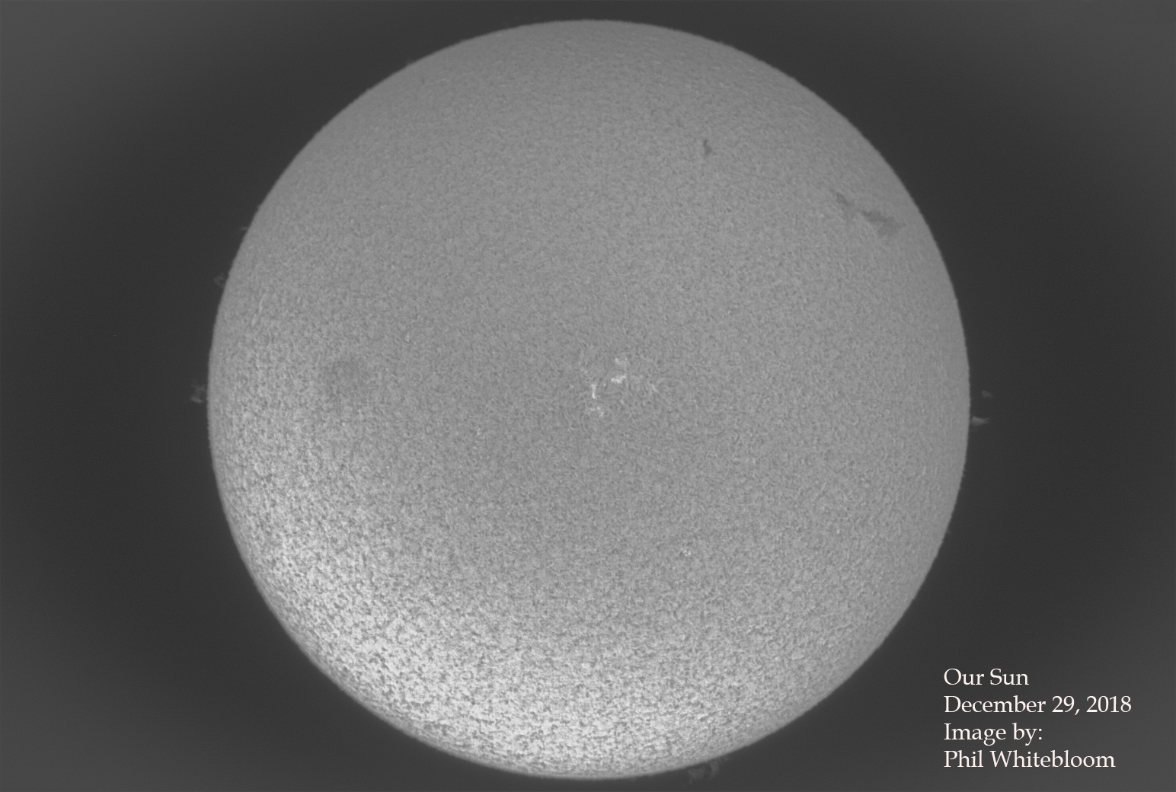

Slide 12
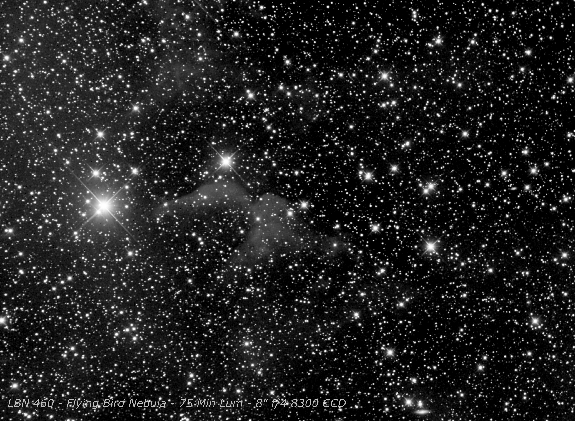
Gene Handler

Slide 13
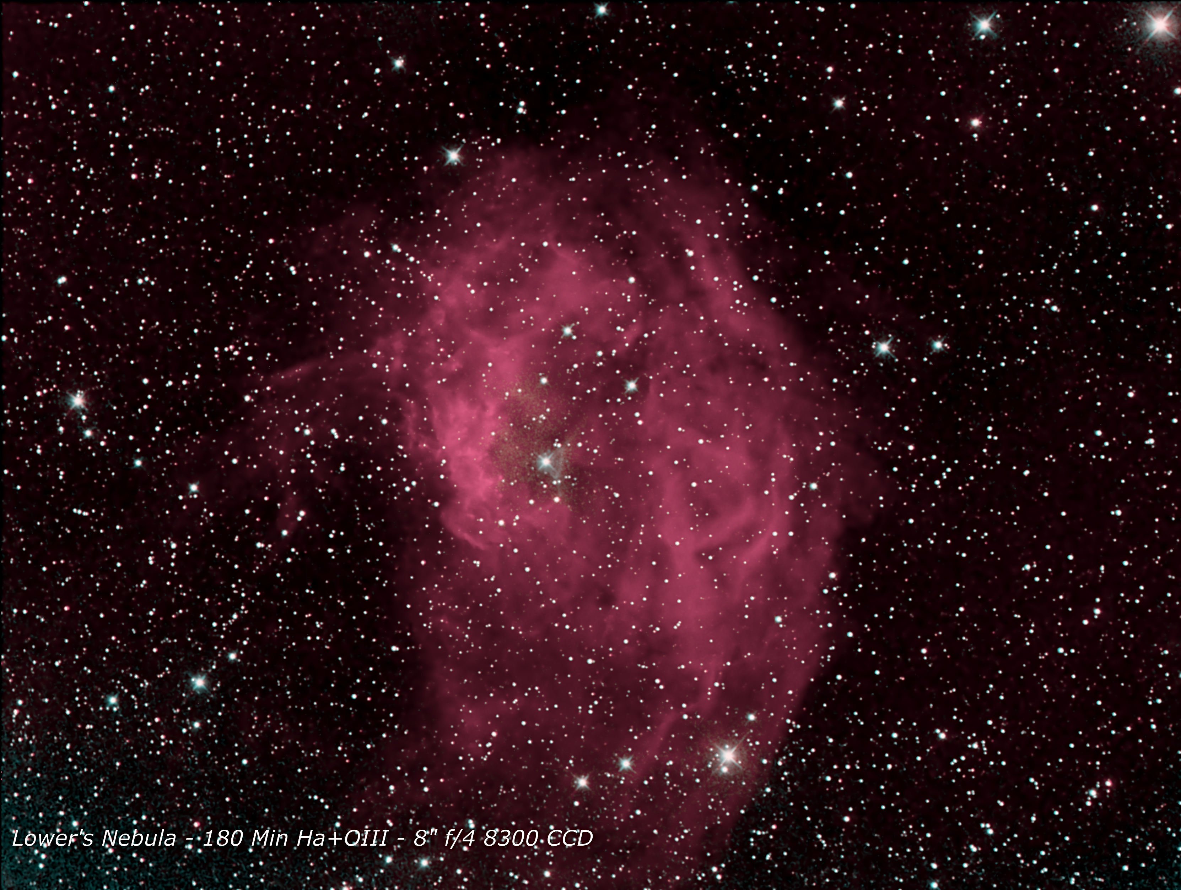
Gene Handler

Slide 14
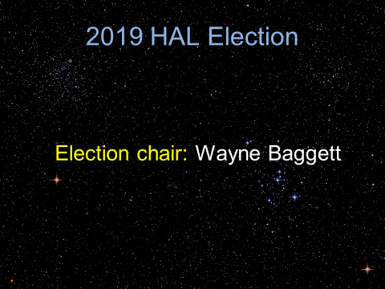
Duane Dehnert

Slide 15
2019 HAL Election
Only one nominee for each for the six elected HAL Board positions:
President Phil Whitebloom
1st Vice President Mike Krauss
2nd Vice President Victor Sanchez
Secretary Cheryl Kerr
Treasurer Chas Rimpo
Events Coordinator David Stein

Slide 16
2019 Election Wrap Up
Transitions in Elected Positions
Oncoming
Phil Whitebloom, President
Victor Sanchez, 2nd VP
Cheryl Kerr, Secretary
Chas Rimpo, Treasurer (2018 Webmaster)
Remaining
Mike Krauss, 1st VP
David Stein, Events Coordinator
Off going
Jim Johnson, President
Bob Dutilly, 2nd VP
Paul Montanaro, Secretary
Bob Savoy, Treasurer
Appointed Position Volunteers (Subject to appointment by president elect Whitebloom)
Paul Montanaro, Webmaster (2018 Secretary)
Bob Dutilly, Librarian (2018 2nd VP)

Slide 17
Thank You!
Next month’s meeting is on Thursday, February 21st 2018 at 7 PM
Dr. Mark Perry
Ring Rain and Tar Polluting Saturn:
A New Understanding of the Interactions between Saturn and its Rings

